Slide 1

j
M
k
n
t
z
u
s
i
e
k
a
u
c
c
d
t
a
o
j
e
n
i
m
k
i
e
s
r

Slide 2
Museum Documentation Centre
DIGITAL HERITAGE OF CROATIAN MUSEUMS IN THE CONTEXT OF THE
THE PROJECT ‘CROATIAN VIRTUAL MUSEUMS’
The Sixth SEEDI Conference
Digitization of cultural and scientific heritage
Zagreb, Republic of Croatia
May 18-20, 2011
Lada Dražin-Trbuljak
Markita Franulić
Doroteja Živčec

Slide 3
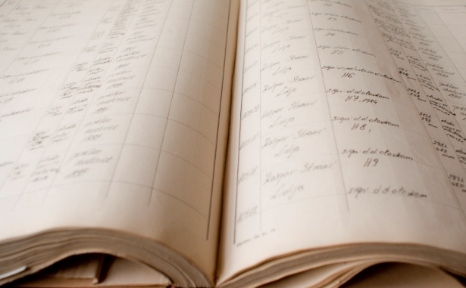
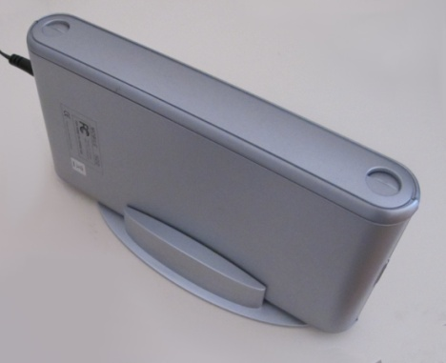
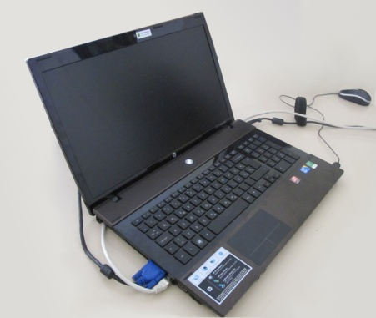
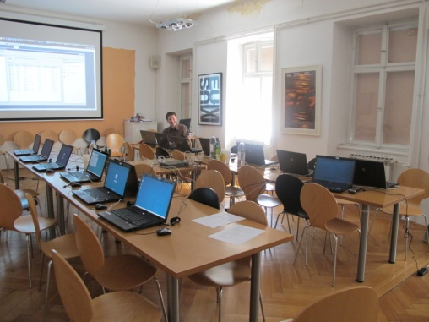
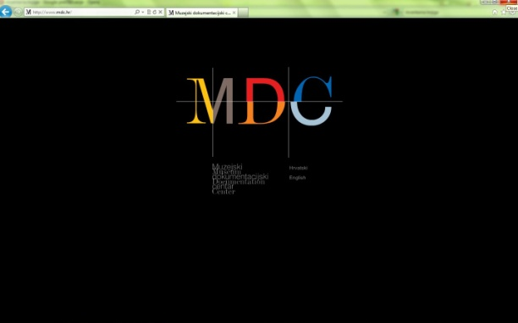
Central database backup system for Croatian Museum Network (University Computing Centre SRCE and MDC)
1976 – SELGEM (Smithsonian institute)
1980 – MODES (MDA)
1994 – Micro CDS/ISIS (UNESCO)
1996 – Paradox 7.0 (MDC)
2004 – M++ (Link2)
www.mdc.hr
education of professional staff for work with the program are being carried on continuously
(50 workshops with 1400 participants from 2005.)

Slide 4

Project Croatian Virtual Museums (HVM) http://www.mdc.hr/muzeji.aspx
A part of the MDC museum portal www.mdc.hr, since 2008
Financial support by the Ministry of Culture - National digitization project in 2008 & 2009
The objectives:
  to create the platform for presentation of all the museums in Croatia at 3 levels:
  - museum level
  - collection level
  - item (museum object) level
  to present museum activities
The skeleton of the system is the museum profile page
The structure is modular and new data, units and projects can always be added or to all museums or to a profile of a single museum.
Notes:
In the context of the topic of the Conference this is an example of connecting information related to museums that include museum, archive and library material that come from many sources but are processed and presented by one institution.
Our aim was to create the system of presentation of museums which will be based on the existing documentation managed by the MDC, where all the information about a museum, from dispersed sources, will be connected in a whole presenting the museum, collection, activities, museum objects and individuals.
At the same time the system must be open in order that data from other resources can be added.

Slide 5
Starting points
The museum portal (since 2005)
The existence of content as the result of long-term collecting and documentation work in the MDC – but the content was dispersed in separate presentations of diverse databases
The project Croatian Museums on the Internet (MHI) (1997 -2008)
Calendar of Events – a CMS application for recording of museum activities (since 1999)
Deficient number of catalogued museum objects in Croatia encouraged us to focus on collection level description
More than 1 million of museum objects digitized in last 5 years
The warranty of the continuity of the project and the updating of data because the project is based on the regular work of the MDC
Notes:
Starting points
3) MHI - The project was conceived as a guide through museums, their collections, the most representative segments of their holdings, museum activities and permanent display. About 50 museums have been presented. Because of the obsolescence of early technological approaches and because the updating was not automated, we decided to archive the existing situation and to reuse /recycle the existing collection descriptions and digitalized objects in new project
4) Calendar - The application offers the possibility to publish news from museums and, at the same time, to create an archive of events divided in 5 groups. We organized workshops on how to work in the application and how to prepare the material
5) The deficient number of catalogued museum objects in Croatia encouraged us to focus on collection level description and on improvement of data about collections, which will then serve as the access point to the catalogue of museum objects, first the highlights of the collection
6) In the meantime, as the result of computerization of Croatian museums, in last 5 years more than 1 million of museum objects were digitized and became potential content of the project.
7)

Slide 6
1st phase (2008)
Connecting 5 online databases regularly managed by the MDC:
Register of museums, galleries and collections in Croatia
Museum posters collection
Library catalogue
The Personal Information Archive of Croatian distinguished Curators
Calendar of Events (news calendar and activity archive)
Notes:
1. faza:
Register of museums, galleries and collections in Croatia
Museum posters collection (about 9000 posters, 1900 online; contains posters published by all Croatian museums since 1950s)
Library catalogue (about 30000 units in electronic catalogue, of 42000 units; library regularly collects publications published by all Croatian museums since 1950s)
The Personal Information Archive of Croatian distinguished Curators (up to date contains oral history records of 105 curators + text & photos)
Calendar of Events (news calendar and activity archive)

Slide 7
2nd phase (2009)
Online publishing of the Register of museums, collections and treasures owned by religious communities
Creation of VR presentations of museum permanent displays
Catalogue of museum objects
Notes:
Online publishing of the Register of museums, collections and treasures owned by religious communities (managed by the MDC) and their connection with museums in unitary presentation of Croatian museum community, but with different search and presentation structure because of specific structure of data about them
Creation of VR presentations of museum permanent displays - 10 museums will be presented by the end of the year + links from permanent display to highlights of the collections in the Catalogue of museum objects
Catalogue of museum objects – creation of the application for the digital repository of museum objects from different (possibly most of) Croatian museums, using data from museums databases

Slide 8
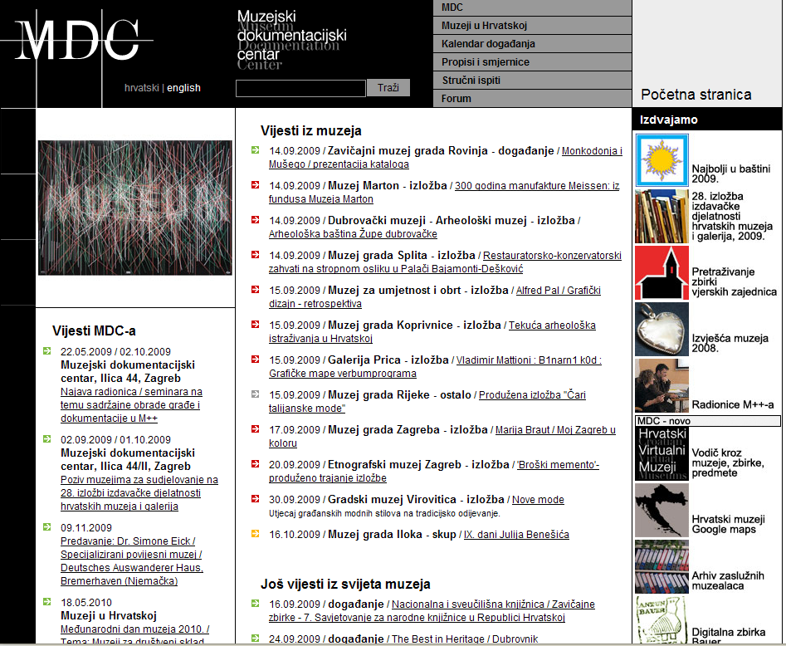
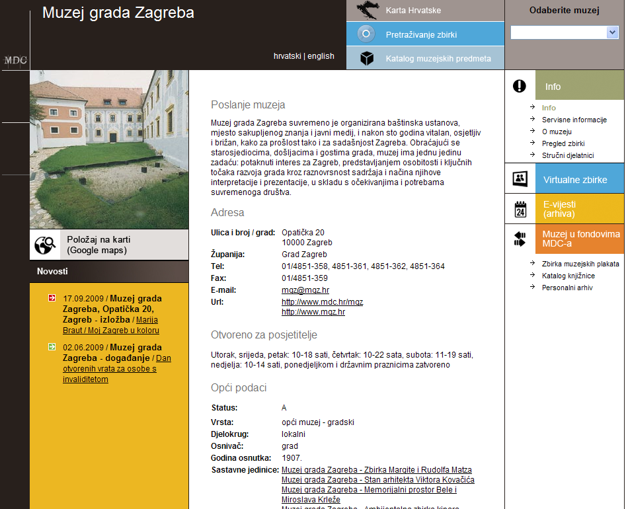
Design
Follows the structure of the whole MDC web site (3 main regions)
Introduction of colours derived from MDC logo
Design of the museum profile page is same for all museums
Notes:
1) Because of limited finances we were forced to keep that structure and to fit into it the project HVM.
Nevertheless that was restrictive, that has a positive side: as in the project we use the existing pages in new context - there is no discrepancy in visual display.

Slide 9
MDC Web site Home Page
Entering points to the HVM
site

Slide 10
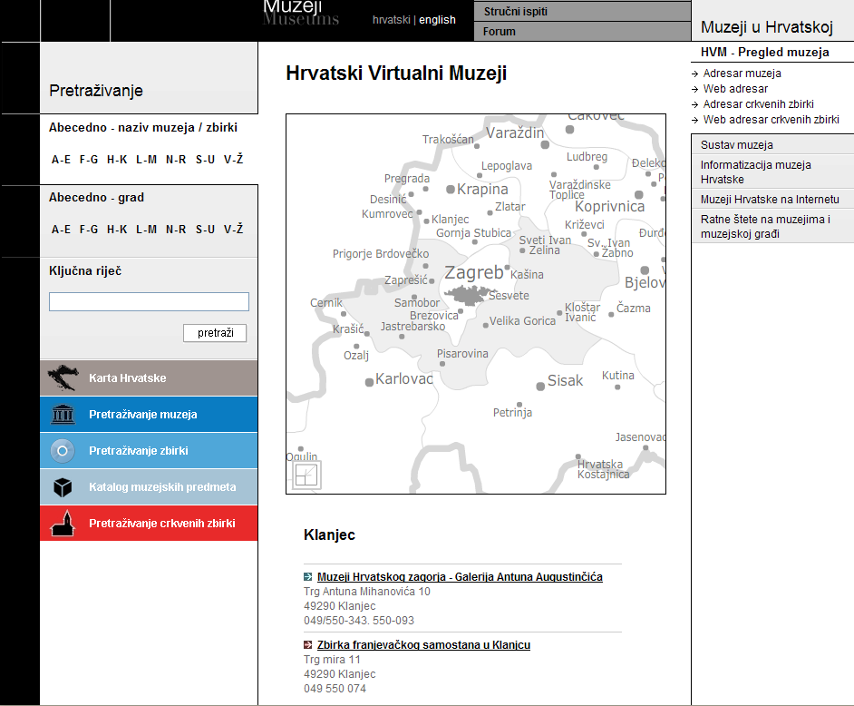
HVM Home Page
Search
Addresses
by alphabet – name of museum
by alphabet –city
by key word
HVM-HP
Museums – complex search
Museums – search of collections
Catalogue of m. objects
Search of “church” collections
Results of the selection on the map
museum
“church” collection

Slide 11
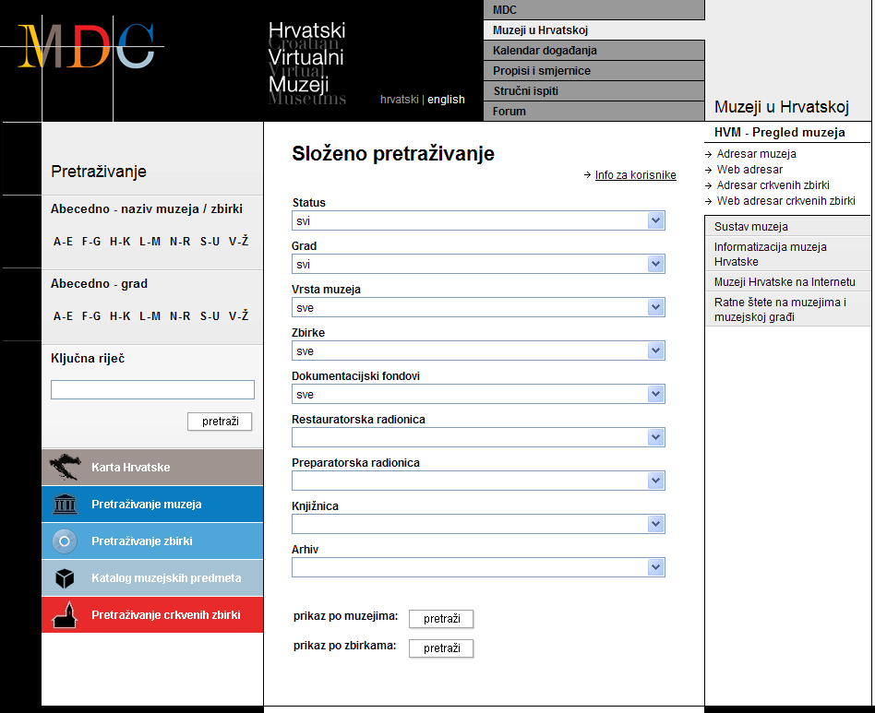
Museums – complex search
Status
City
Type of museum
Collections
Documentation funds
Restoration Workshop
Preparation Workshop
Library
Archive
Display list of museums
Display list of collections

Slide 12
Museum profile page
Select a museum
Info
Picture
rotator
Virtual coll.
News-archive
News
Museum in MDC funds
Poster coll.
Library catalogue
Personal archive
Permanent display
Other1
Other2
Other3

Slide 13
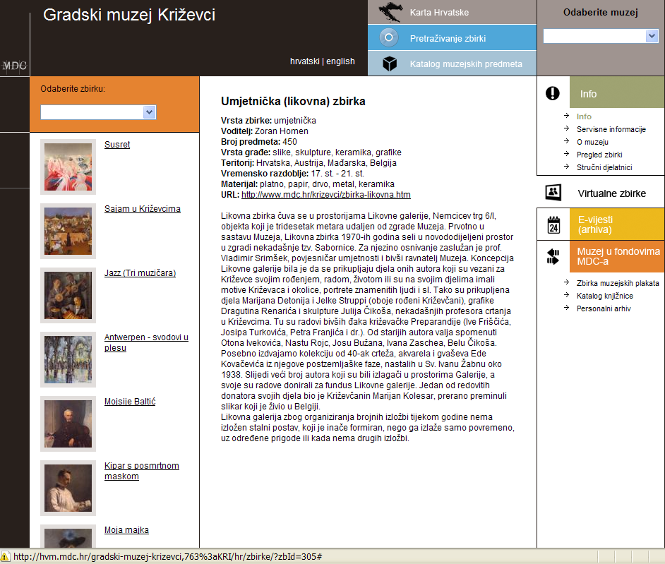
Presentation of a collection
Select a
collection
Museum
objects
from the selected
collection
- highlights

Slide 14
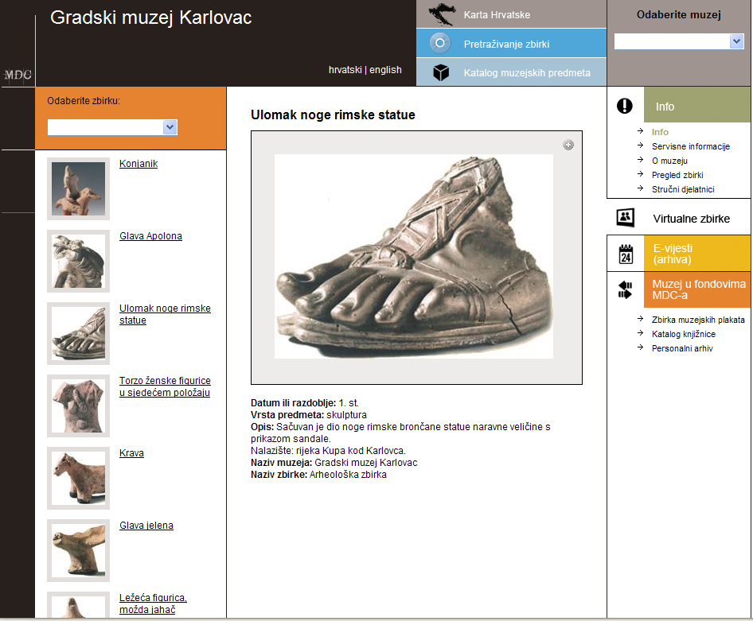
Presentation of a museum object

Slide 15
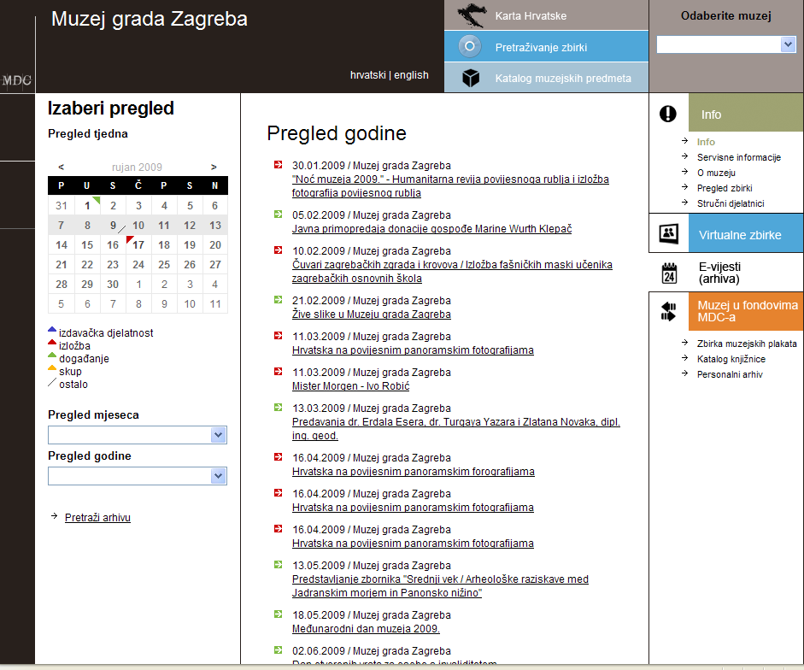
E-news (archive)
Select an overview:
by week
> publications
> exhibitions
> events
> seminars /workshops…
> other
by month
by year

Slide 16
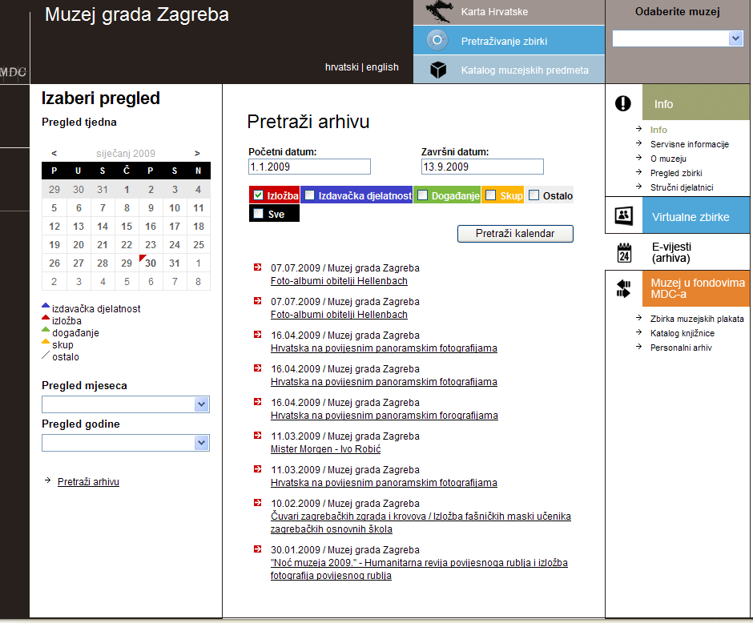
Search of the activities archive of a museum
Search by one
or more
categories
e.g. result:
exhibitions
in selected
period

Slide 17
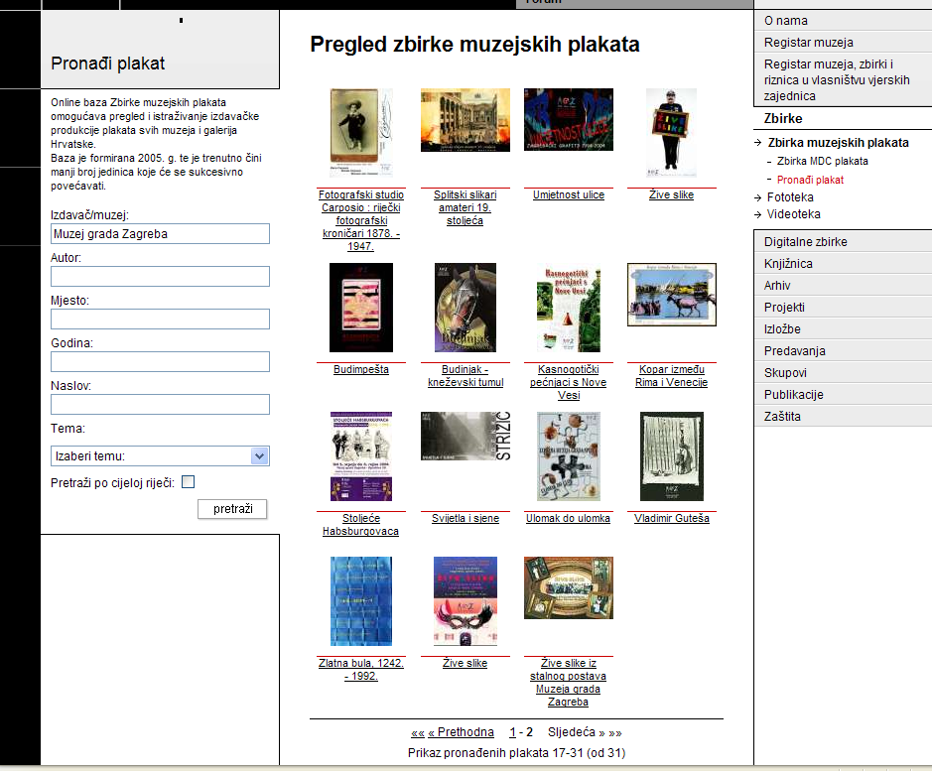
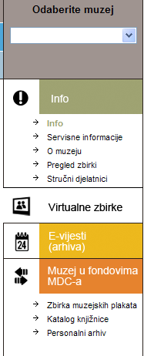
Museum in the MDC funds: Museum posters collection

Slide 18
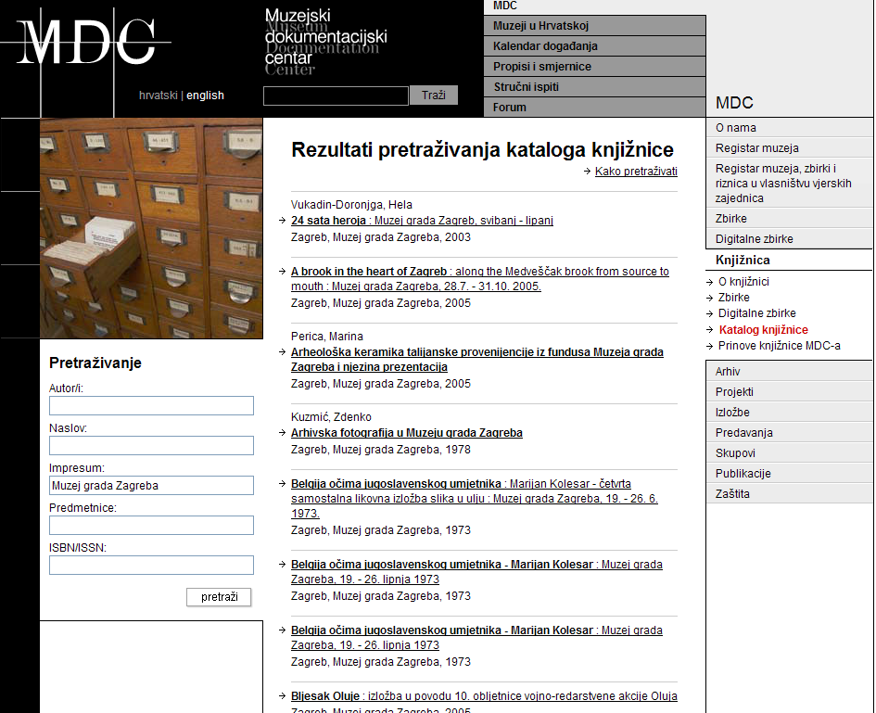
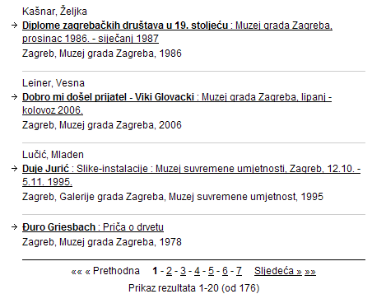
Museum in the MDC funds: Library catalogue

Slide 19
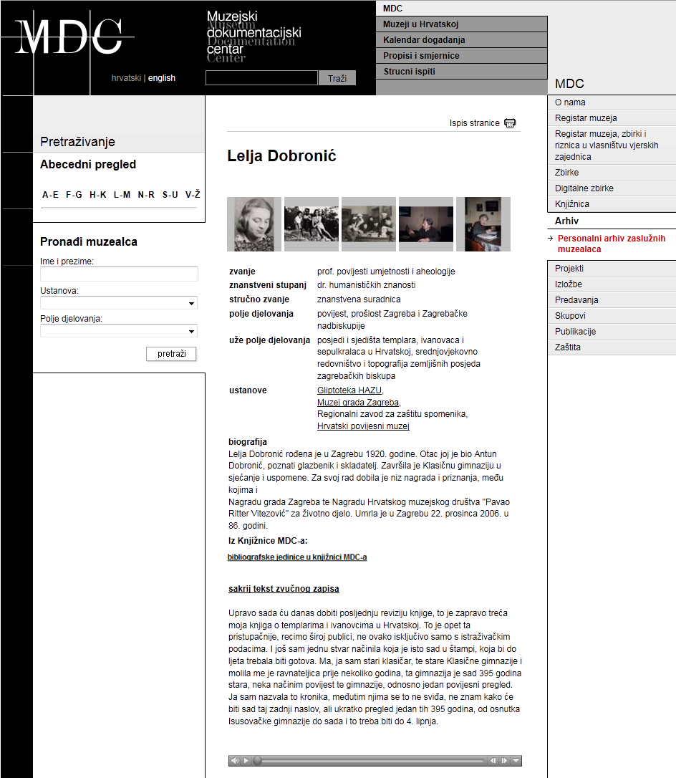
Museum in the MDC funds: Personal archive
link to the bibliography
in the MDC library
audio record

Slide 20
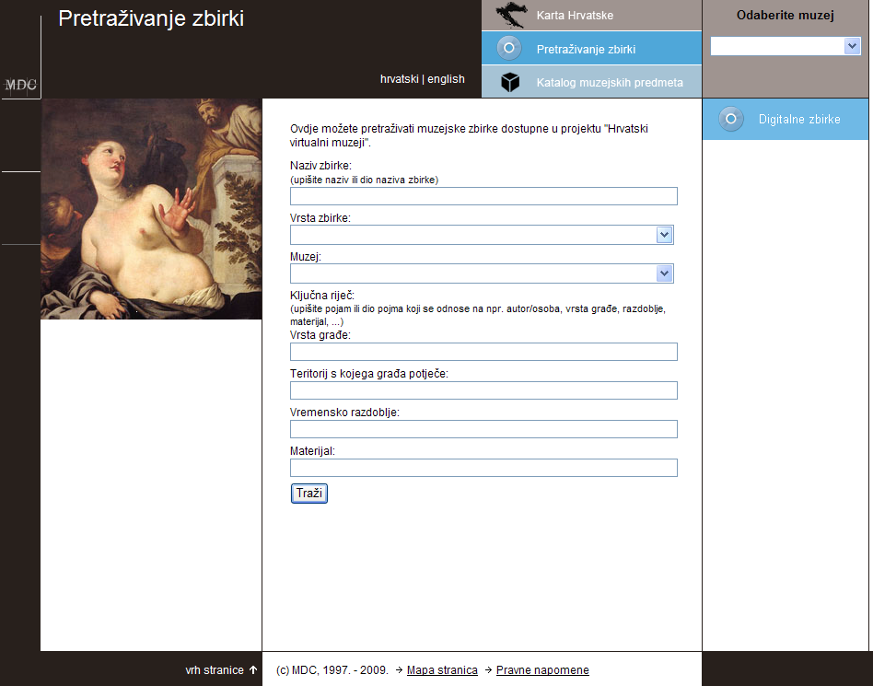
Search of collections
Digital collections
Name of collection
Type of collection
Museum
Key word:
Type of material
Teritory of provenance
Period
Material

Slide 21
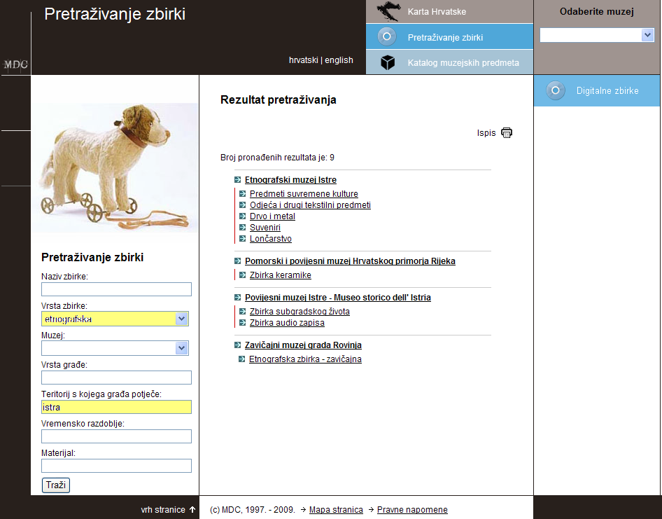
Search of collections - result
Link to the Museum profile page
Link to the collection page

Slide 22
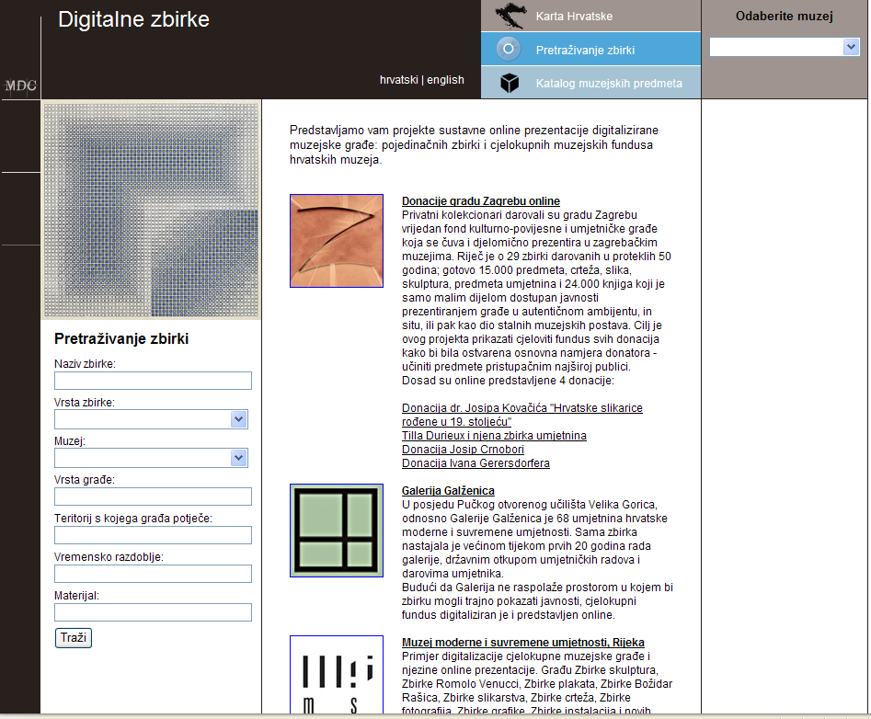
Digital collections - selection
Criteria: projects of
systematic online
presentation of digitised
collections

Slide 23
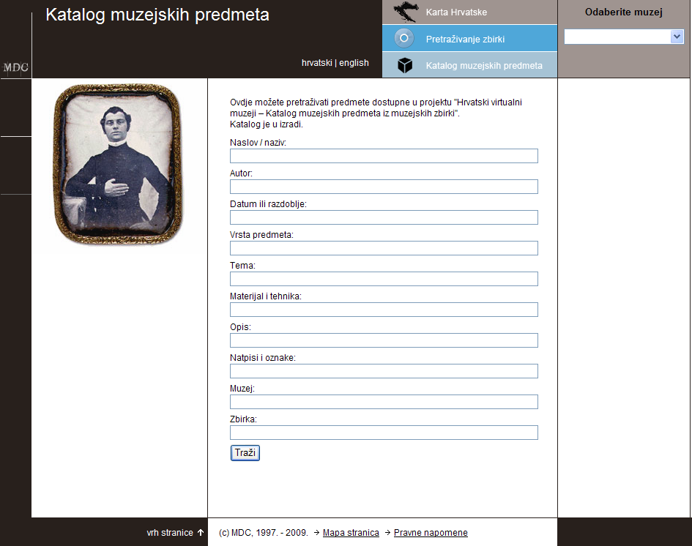
Catalogue of museum objects - search
Selection of Object ID categories
Notes:
…Catalogue of museum objects
The objectives:
to provide that each museum can catalogue museum objects on its profile page
to let you search across the digital collections of different museums from one point
to present the objects of the individual museum in the broader context of Croatian museums and collections
to create the possibility of recontextualisation of museum objects

Slide 24
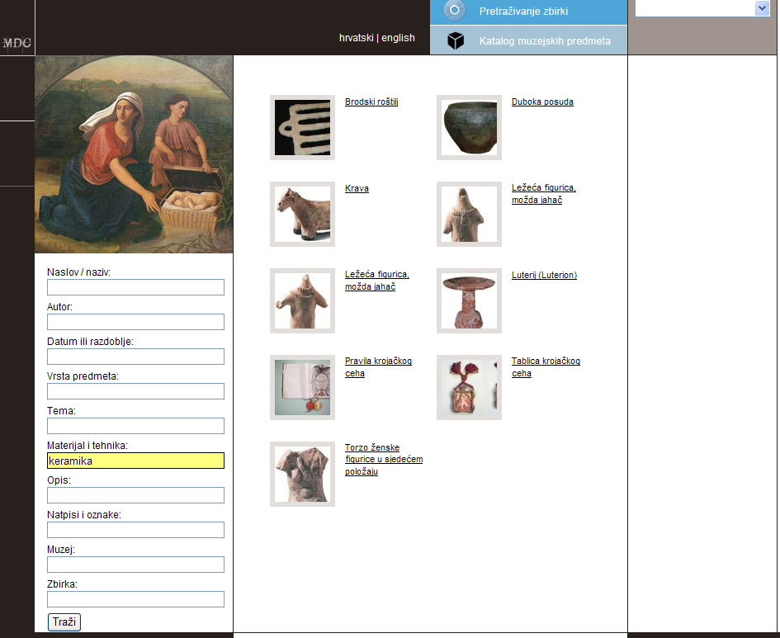
Catalogue of museum objects – search result
e.g. result: search by
material & technique
“ceramics”
Notes:
…Catalogue of museum objects
Still a pilot project
The set of data that describe an object corresponds to the Object ID categories
The idea of recycling / reusing the existing photos from the project MHI failed, because of technical reasons
The automatization of the system - the collection management system (M++) is adapted to export a set of data to XML format which will be transferred into our web application for museum objects.
The museums that don't have technological possibility to automate the data export, can send us data and photos in different forms and we will create a record of their object

Slide 25
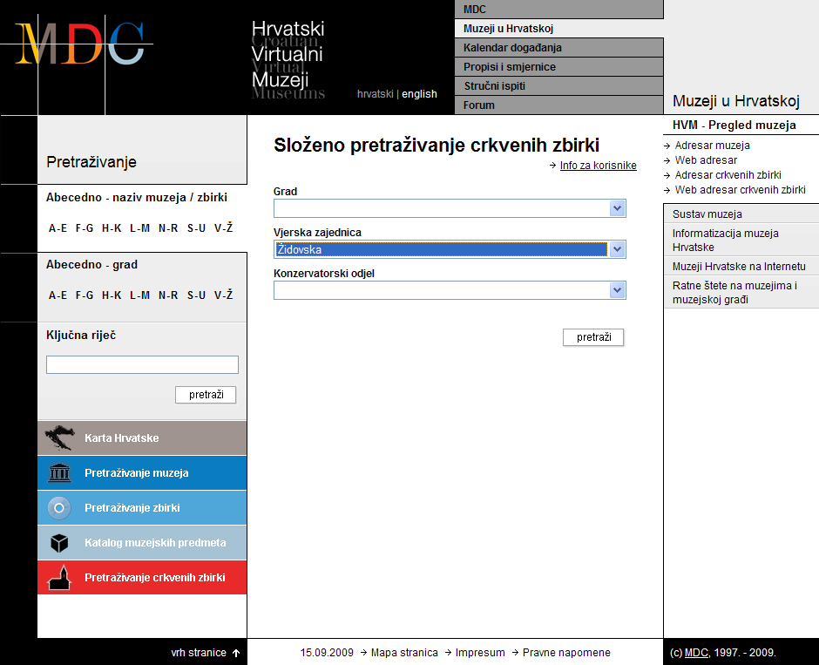
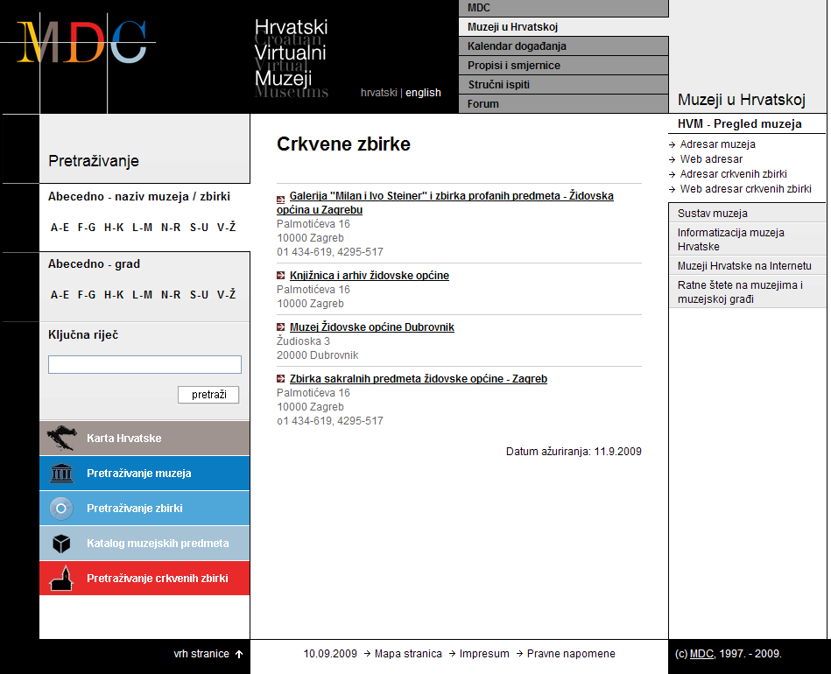
“Church” collections – search & search result

Slide 26
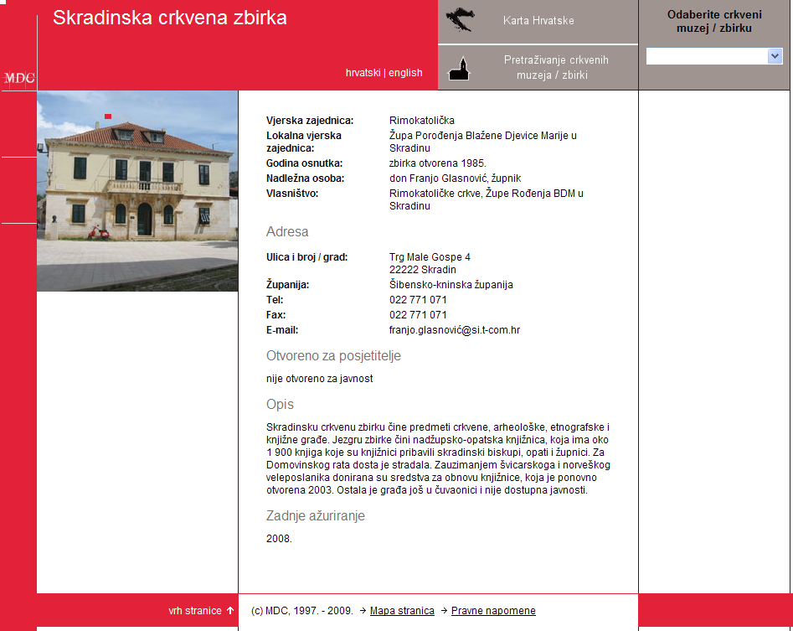
“Church” collection profile page

Slide 27
Visits to the web site
High ranking of the museum profile pages on Google search which is very often the 1st access point to museums and cultural heritage
about 1300 visits per day
70% from Croatia
more than 50.000 backlinks
Links on tourist web portals, Ministry of Culture - "culturenet" portal, information portals like "where to go" and archive, library and museums web sites

Slide 28
Benefits of the project
The provision of a single entry point for obtaining information on, and searching of, Croatian museums and collections
Picture of the complete museum scene in the country, including the smallest museums and church collections which resources are not sufficient to make their own web presentation
MDC as institution with long tradition of professional work and regular financing is the warranty for accuracy and consistency of information & for the continuity of the project
Enhanced access to collections in Croatian museums and their promotion, now nationally and internationally,when the content will be translated in English
Notes:
3) MDC as institution with long tradition of professional work and regular financing is the warranty for accuracy and consistency of information & for the continuity of the project
That is the core to which different short-term and medium-term projects can be added

Slide 29
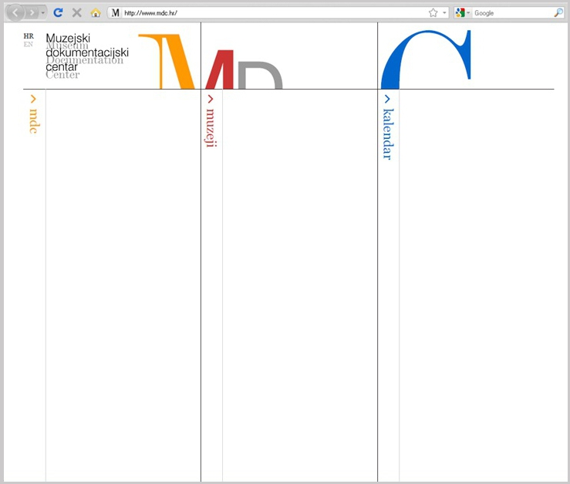
www.mdc.hr

Slide 30
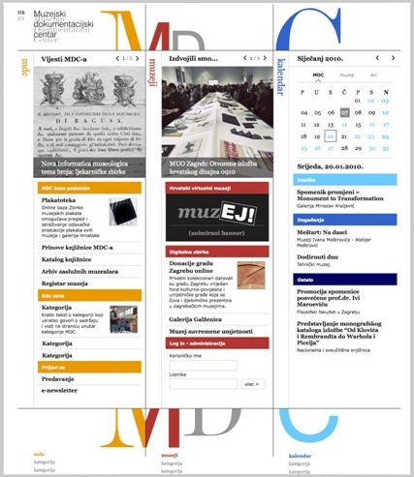
www.mdc.hr

Slide 31
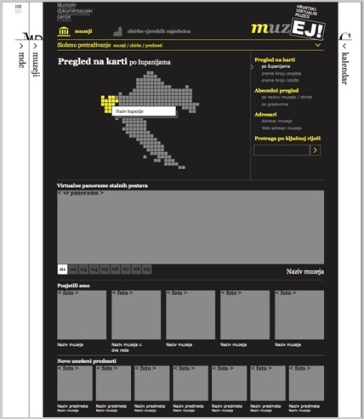
muzEJ!

Slide 32
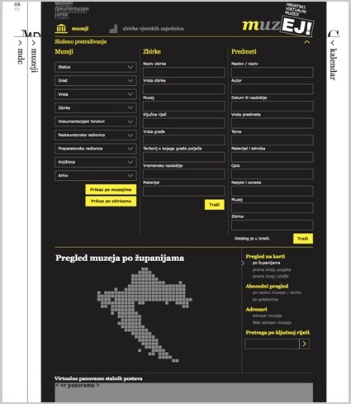
muzEJ!

Slide 33
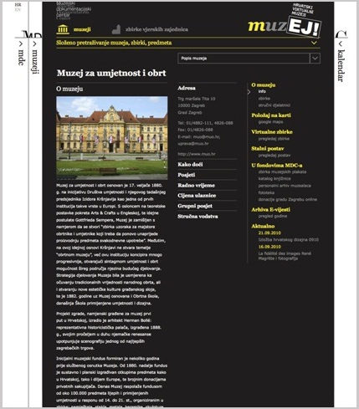
muzEJ!

Slide 34
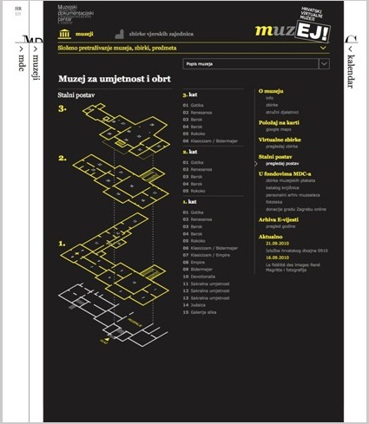
muzEJ!

Slide 35
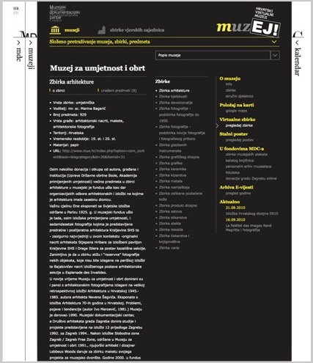
muzEJ!

Slide 36
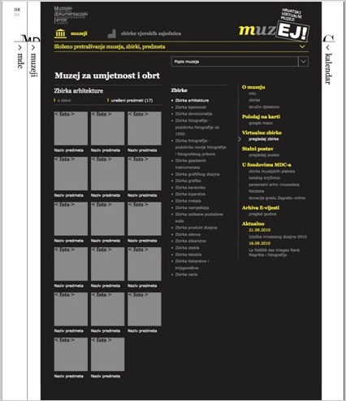
muzEJ!

Slide 37
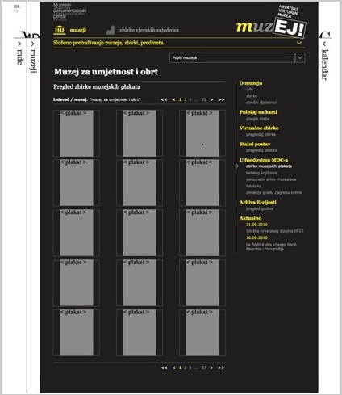
muzEJ!

Slide 38
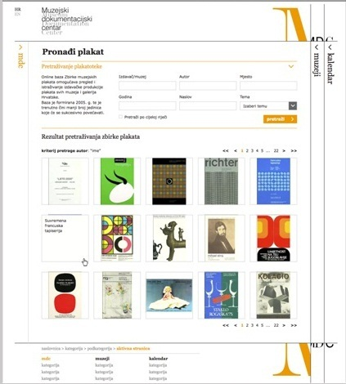
Online baze MDC-a

Slide 39
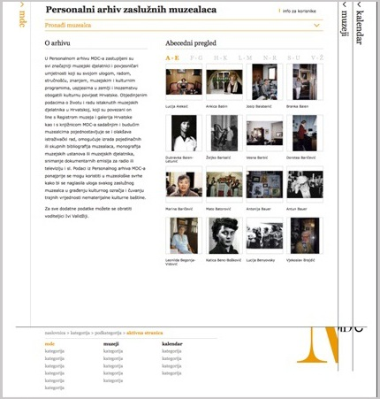
Online baze MDC-a

Slide 40
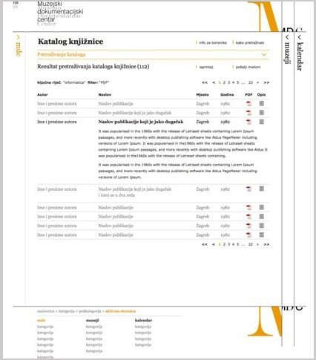
Online baze MDC-a

Slide 41
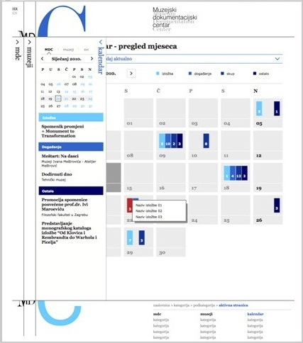
Kalendar događanja

Slide 42
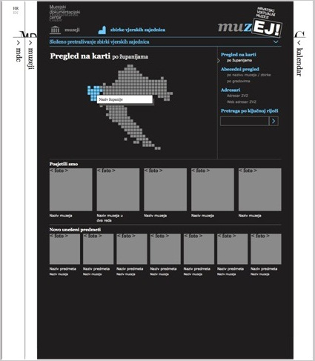
muzEJ!

Slide 43
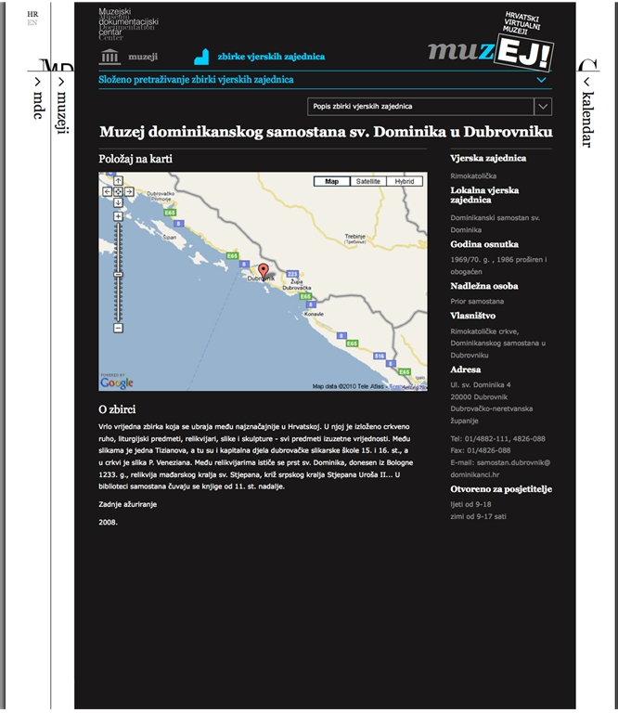
muzEJ!

Slide 44
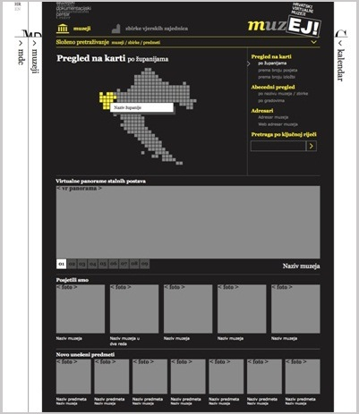
muzEJ!
http://novena.hr/vr/mdc/narona/index.html

Slide 45
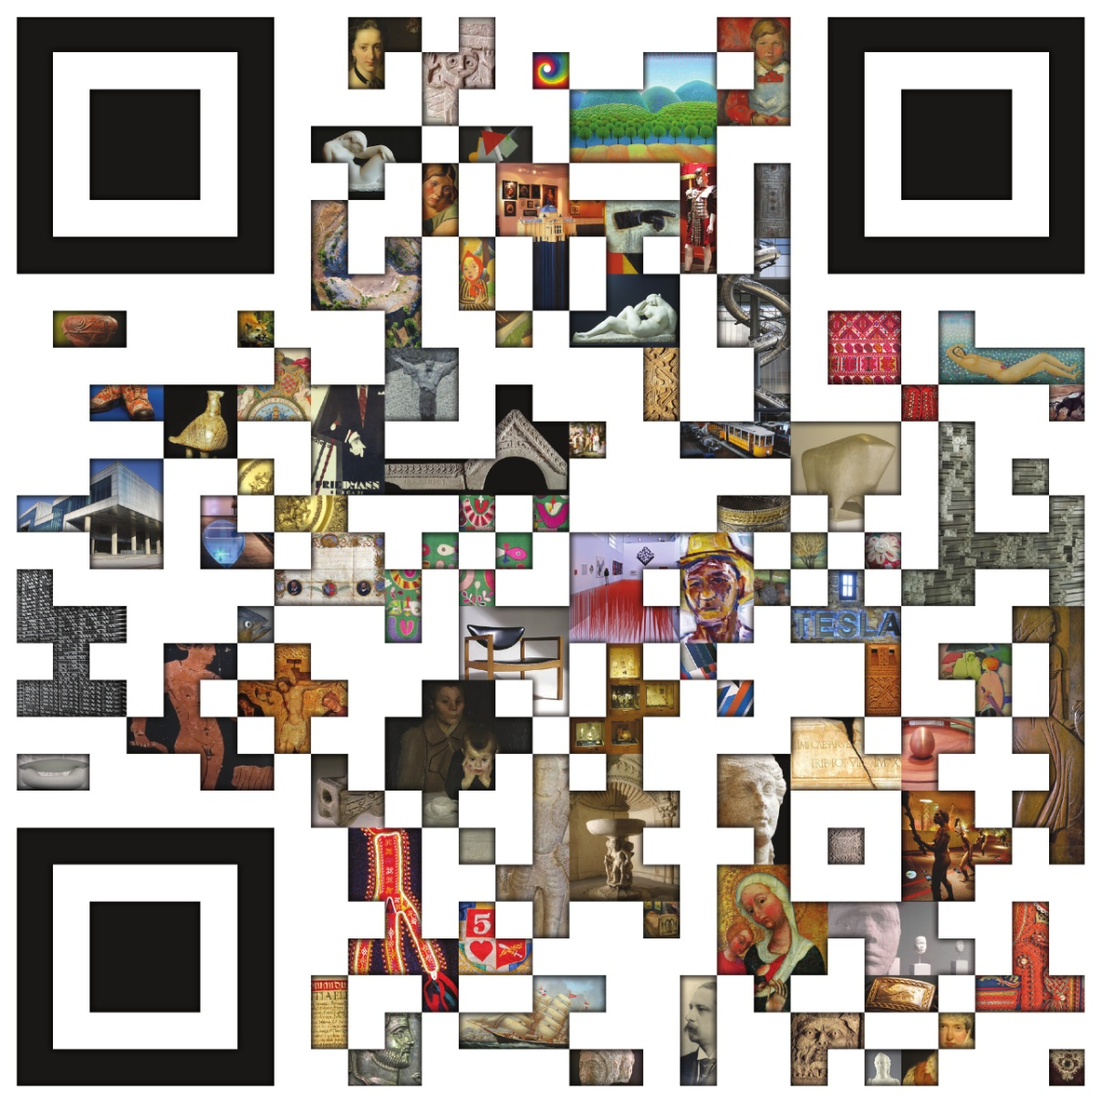
Hvala.

